Slide 1
Ethereum Whale Analysis
DSC 190 - Graph Networks
Kevin Morales-Nguyen

Slide 2
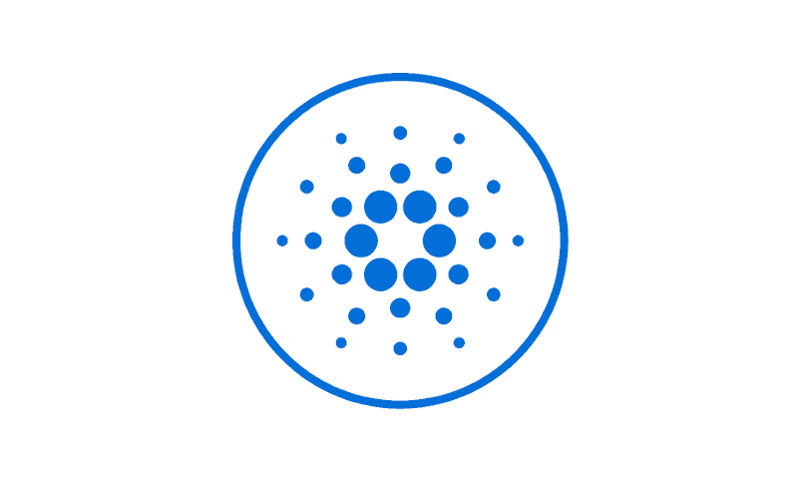


What is a Blockchain?
Public/Private distributed ledgers
Networks are decentralized, data is stored individual nodes
Different consensus protocols for different blockchains, PoW,PoS,
Most popular implementations as cryptocurrencies

Slide 3
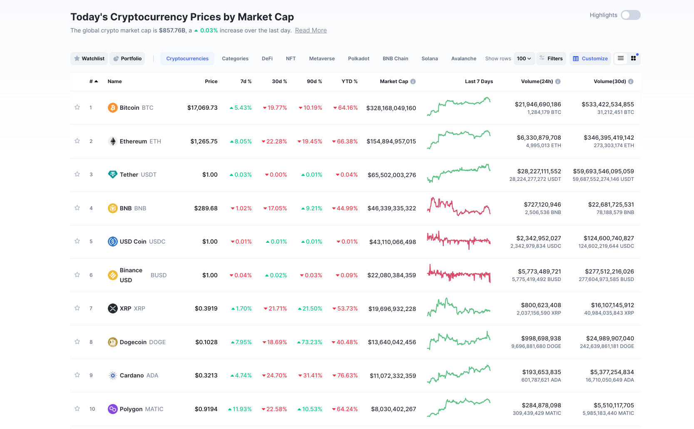

Slide 4
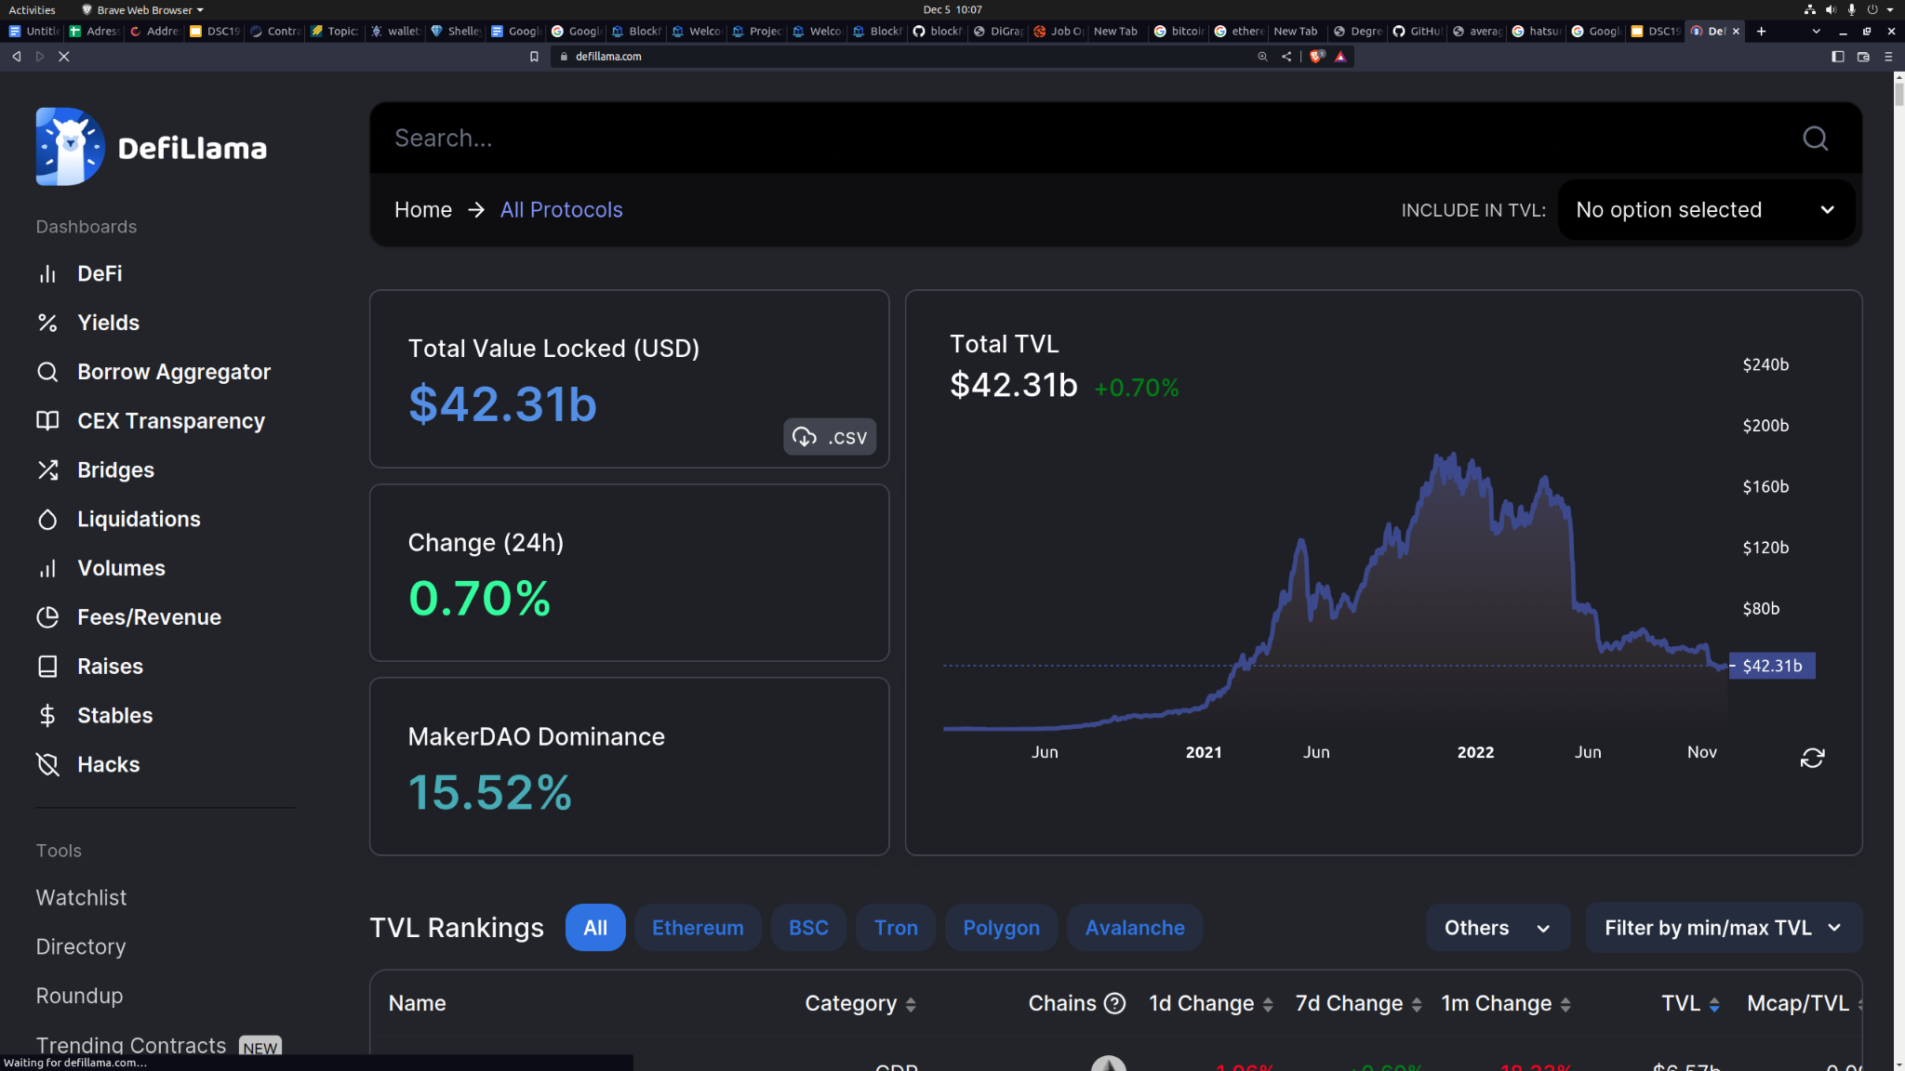

Slide 5
Motivation
Can we represent cryptocurrency transactions as an graph network
Better understand the trading behavior of top holders, can key graph measures define or be informative of trading behavior or market conditions
How do these measures change in a bull or bear market

Slide 6
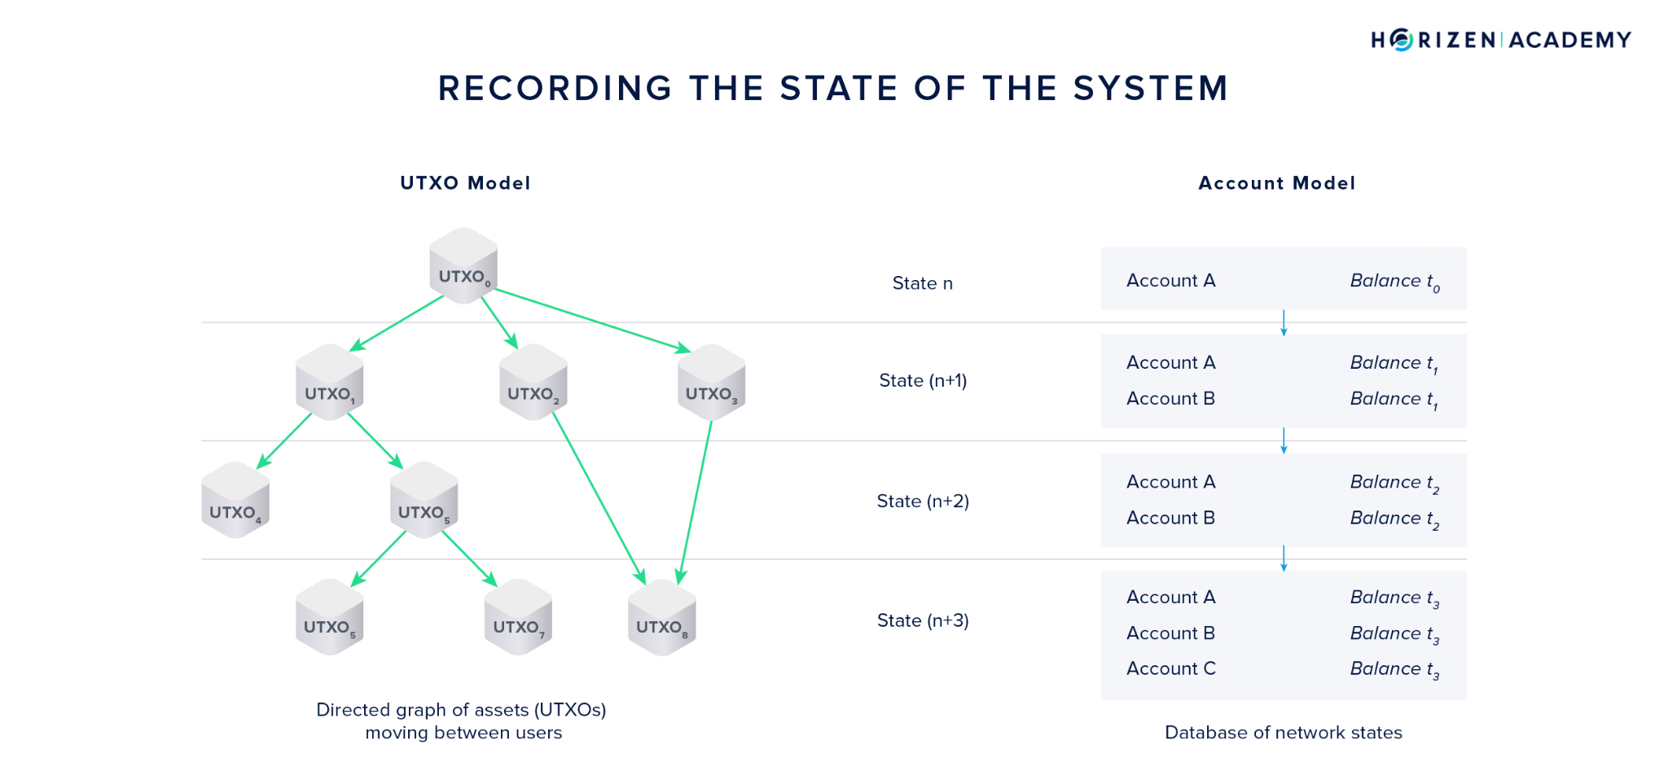
Network Representation and Accounting Models

Slide 7
Data Acquisition and Cleaning
1: Pull addresses that comprise top 51% of circulating supply
2: Remove exchanges and contracts
3. Pull transaction history for remaining accounts via Etherscan api

Slide 8
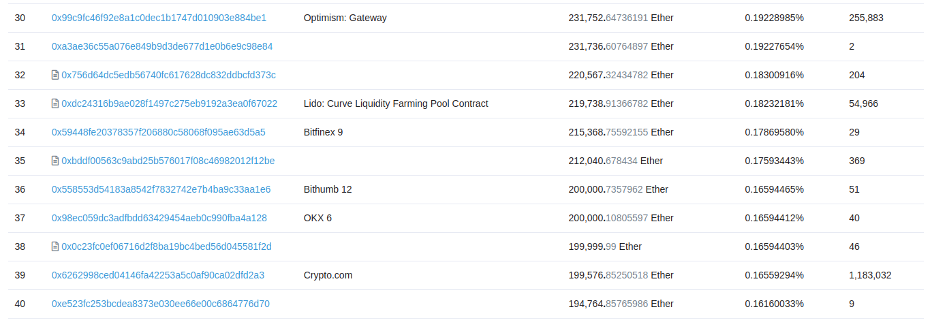
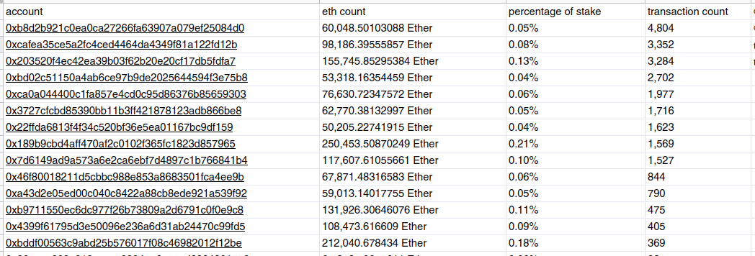
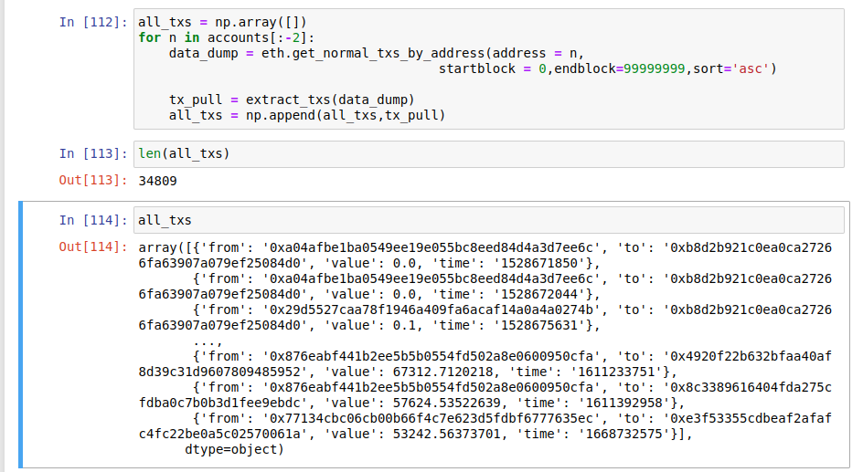

Slide 9
Seed Node Statistics
 | % of total stake | # of accounts | transaction count | Stake % / accounts
Before | 51.03 | 300 | 54,928,558 | 0.1701
After | 19.58 | 229 | 35985 | 0.0855

Slide 10
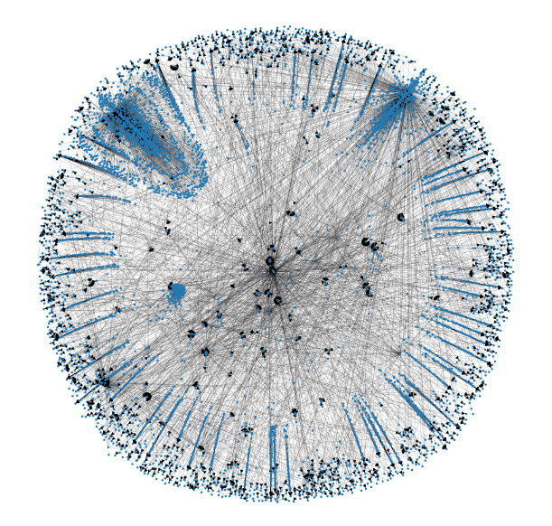

Slide 11
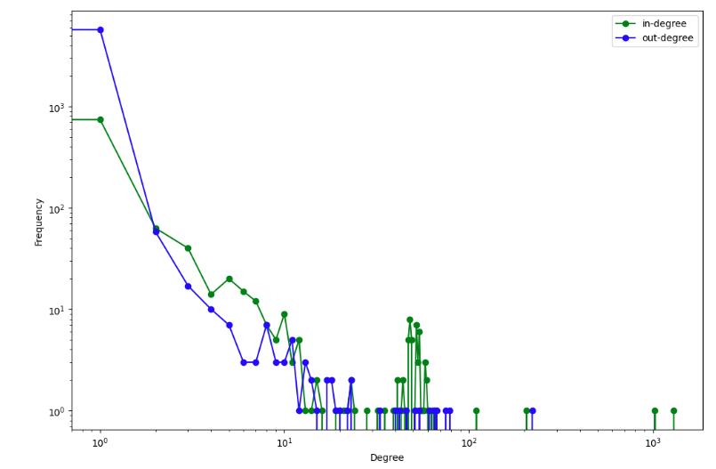
Degree Distribution, other measures
Nodes: 6707
Edges: 7266
Avg degree: 1.0833
Avg clustering coef: 0.00057

Slide 12
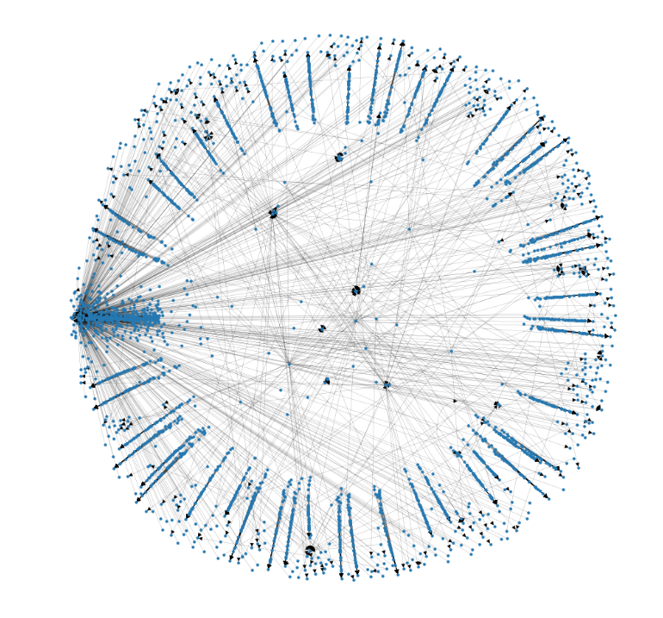
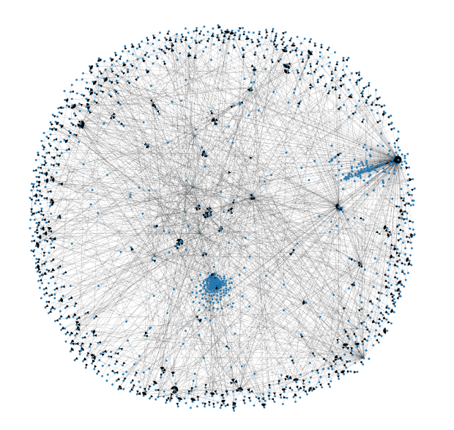

Slide 13
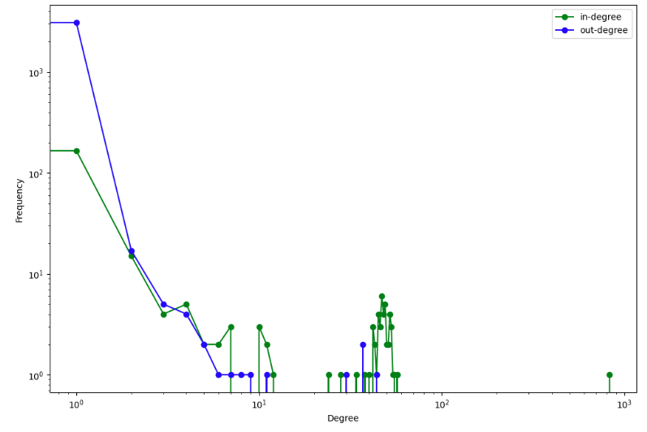
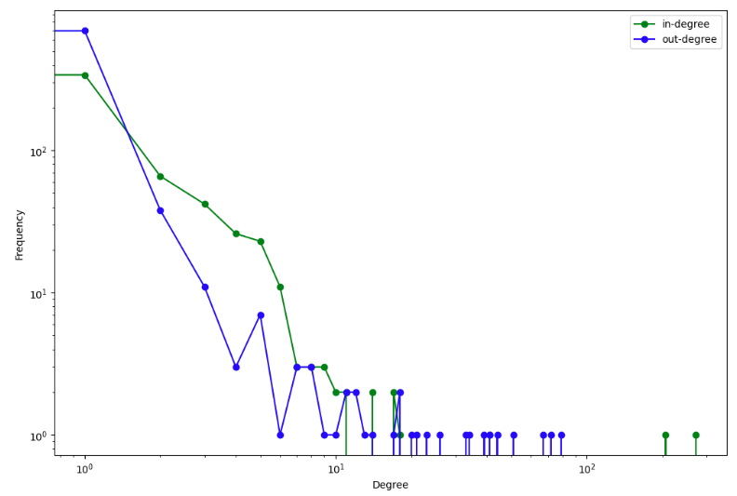
Degree Distribution Bull/Bear cycles
Bull Bear

Slide 14
Bull/Bear graph statistics
 | Nodes | Edges | Avg degree coef. | Avg clustering coef.
Bull | 3341 | 3356 | 1.0045 | 0.00021
Bear | 1226 | 1596 | 1.3012 | 0.00065

Slide 15
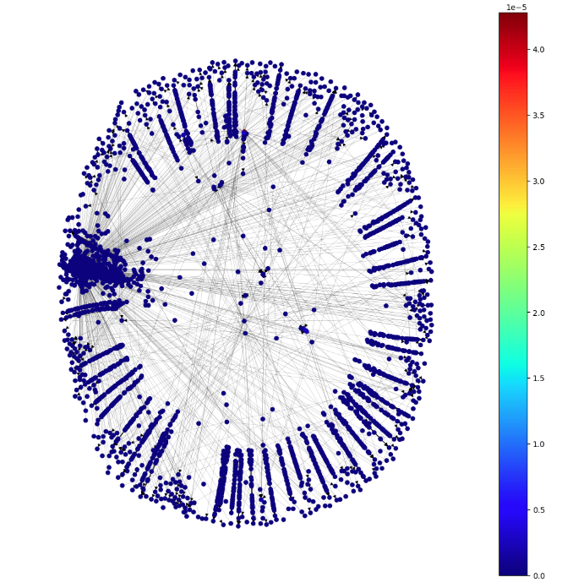
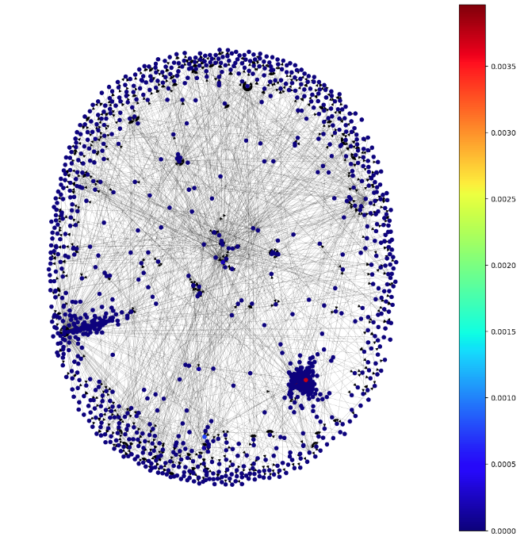
Betweenees Bull/Bear

Slide 16
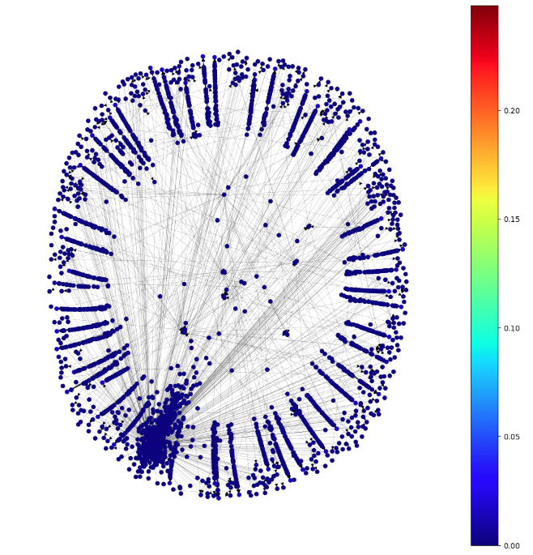
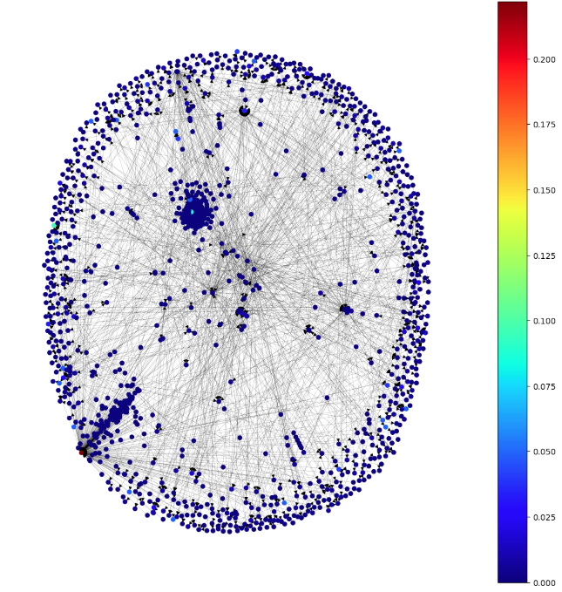
Closeness Bull/Bear

Slide 17
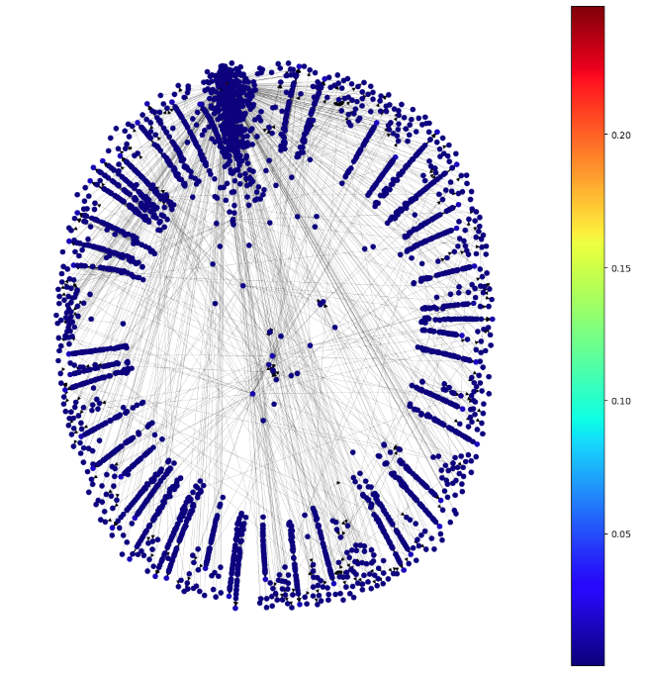
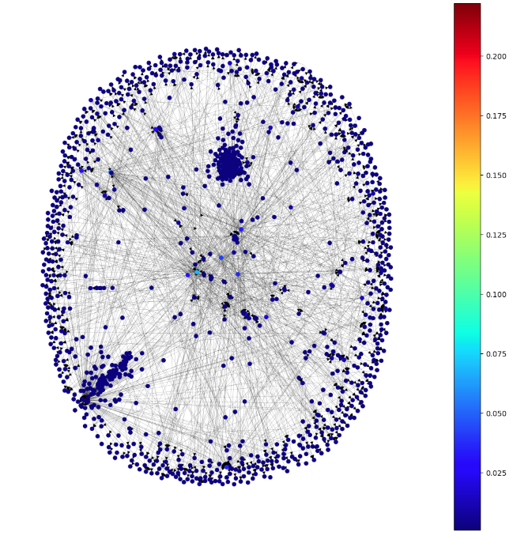
Degree Bull/Bear

Slide 18
Community Detection, Whale collaboration
Defi protocols vs CEX
 | modularity | Girvan Newman
All tx’s | 0.9445 | 0.1228
Bull | 0.9204 | 0.7220
Bear | 0.9152 | 0.6300

Slide 19
Extensions
Full network analysis,
Community growth, network health, decentralization
Price contagion, liquidation detection
Transaction classification for frontrunning markets
Cryptocurrency graph analysis index, key measures
How does transaction cost effect statistics for different models?

Slide 20
Final note
An exciting wild space…
As adoption grow so will the data, perhaps exponentially
Changing ecosystem, blockchain state will change over time
If marketcaps grow there will be demand for analytics, graph networks another tool for insights

